Slide 1

MovieLens Data Exploration and Recommendation System
Yijing Zhou & Yi Wang

Slide 2
Motivation and Tasks
Movies are now an inseparable component of people’s daily life. The trend of the movie industry is highly dependent on audiences’ taste and preference over time. There are several questions that motivate us to select this topic:
What type of movies are among the most popular?
How many differences are there among different users’ tastes?
How does the movie recommendation system work to accurately recommend related movies to users?

Slide 3
Data Description
1M MovieLens Data:
1,000,209 anonymous ratings made during 2000 to 2003
3,900 movies released from 1919 to 2000
6,040 MovieLens users.
Reason for the choice:
It contains user information such as age, occupation, geographic location that help us better understand the questions we raised previously.

Slide 4
Data Attributes
User Data |  | Attribute name
Individual | User ID | gender | age | occupation | Zip code | Ratings made to a specific movie
By State | User number | Female/Male user number | Average age | Occupation distribution |  | Average rating given by the resident user
Movie Data |  | Attribute name
Individual | Released year | Average rating (Overall/by year) (reputation) | Female average rating (Overall/by year) | Male average rating (Overall/by year) | genre | Total amounts of ratings (popularity)
By Genre |  | Total average rating (Overall/by year) | Female average rating (Overall/by year) | Male average rating (Overall/by year) | Occupation distribution of rated users | Total amounts of ratings

Slide 5

System Overview
Our system contains six visualization designs to present our analysis on the movie and user dataset as well as the recommendation system.

Slide 6
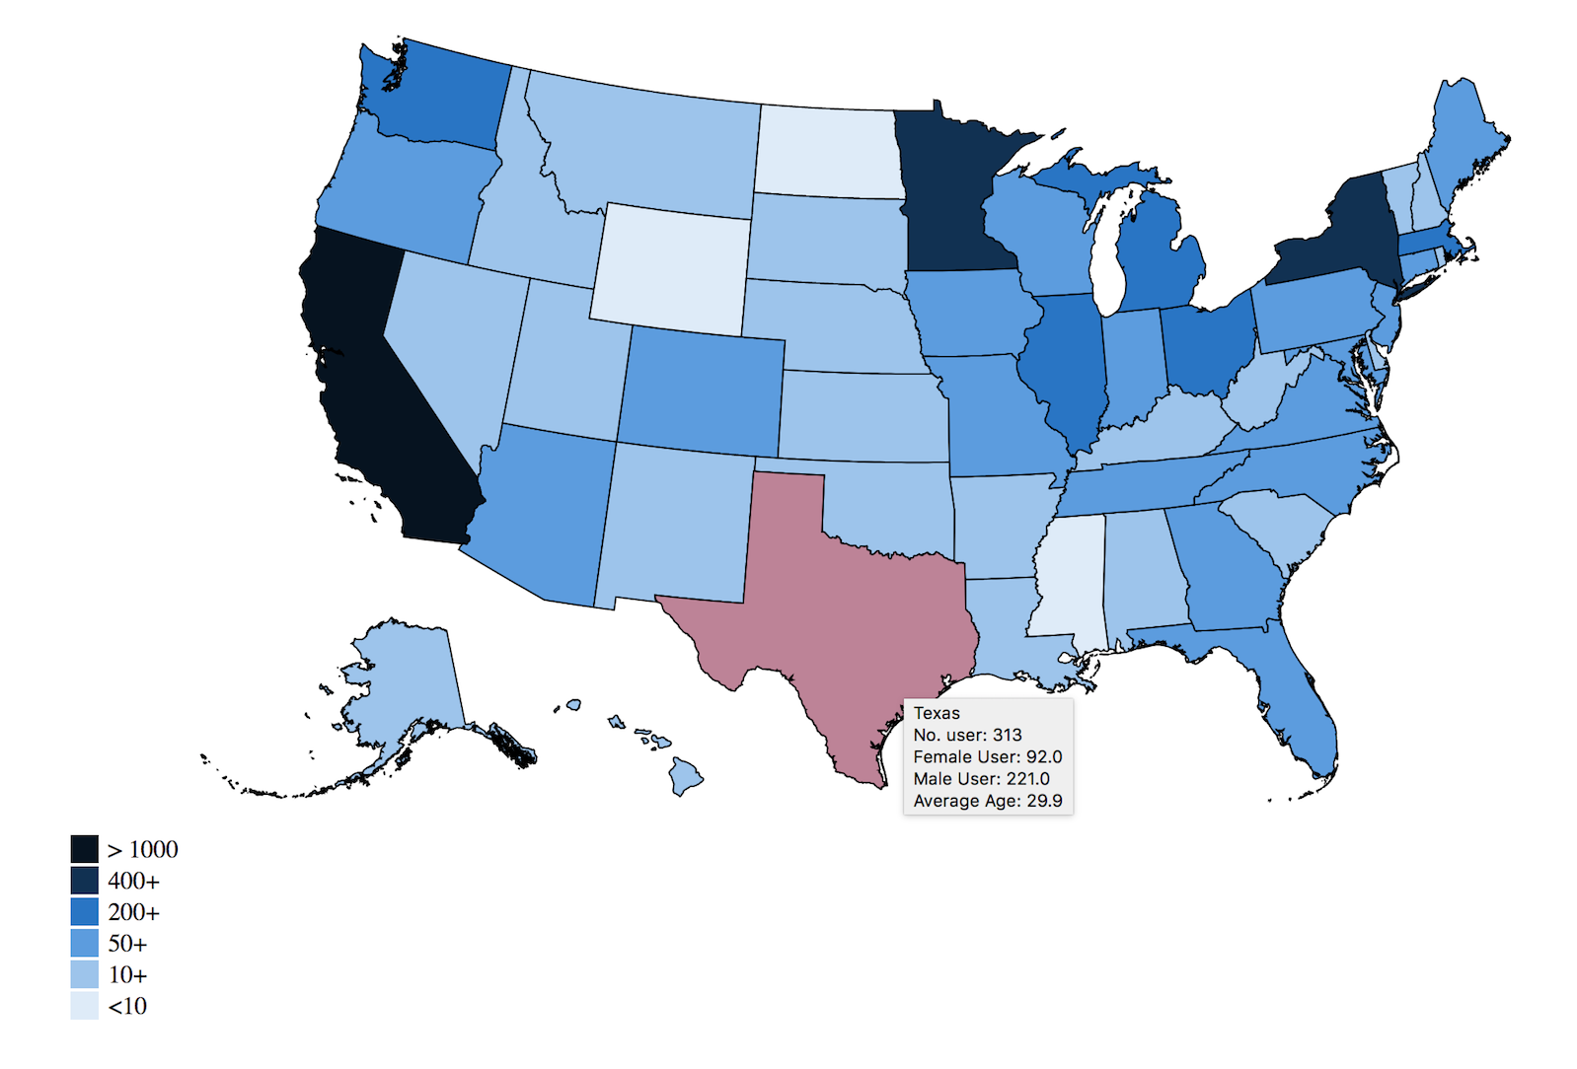
User Map – User Background Information
Task:
Clearly demonstrates the geographic information of the user
Provide a first glance of the MovieLens user background
Visual Encoding:
Color: Number of users
Position: State
Notes:
Findings:
California, New York and Minnesota have the most MovieLens users

Slide 7
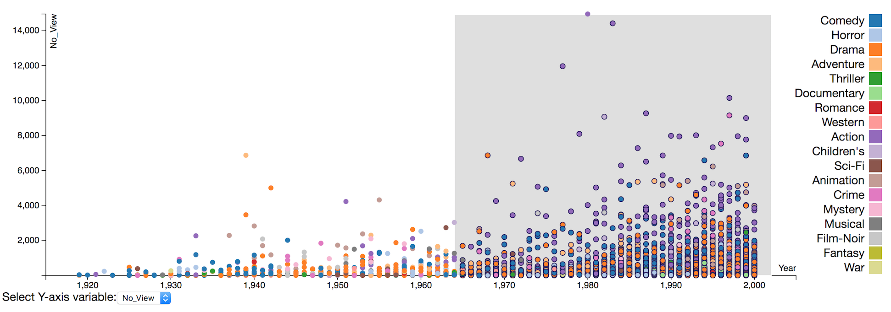
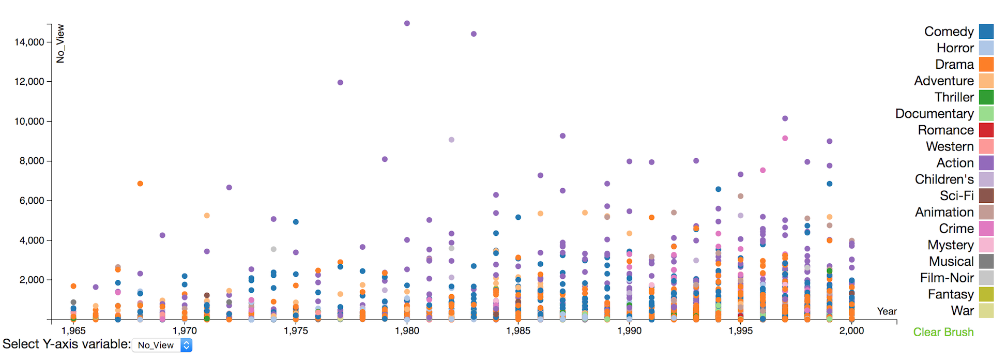
2. Brushable Scatterplot – Movie Ratings/Popularity by year
Task:
Show the distribution of all individual movies
Have an overview of popularity and reputation of all the movies
Visual Encoding:
Color: the genre of each movie
Position: the published year and total view/average rating
Notes:
Findings:
Amount of movies boosted since 1970s
Comedy, Action and Drama have high popularities, whereas the series of Star Wars are the most popular

Slide 8
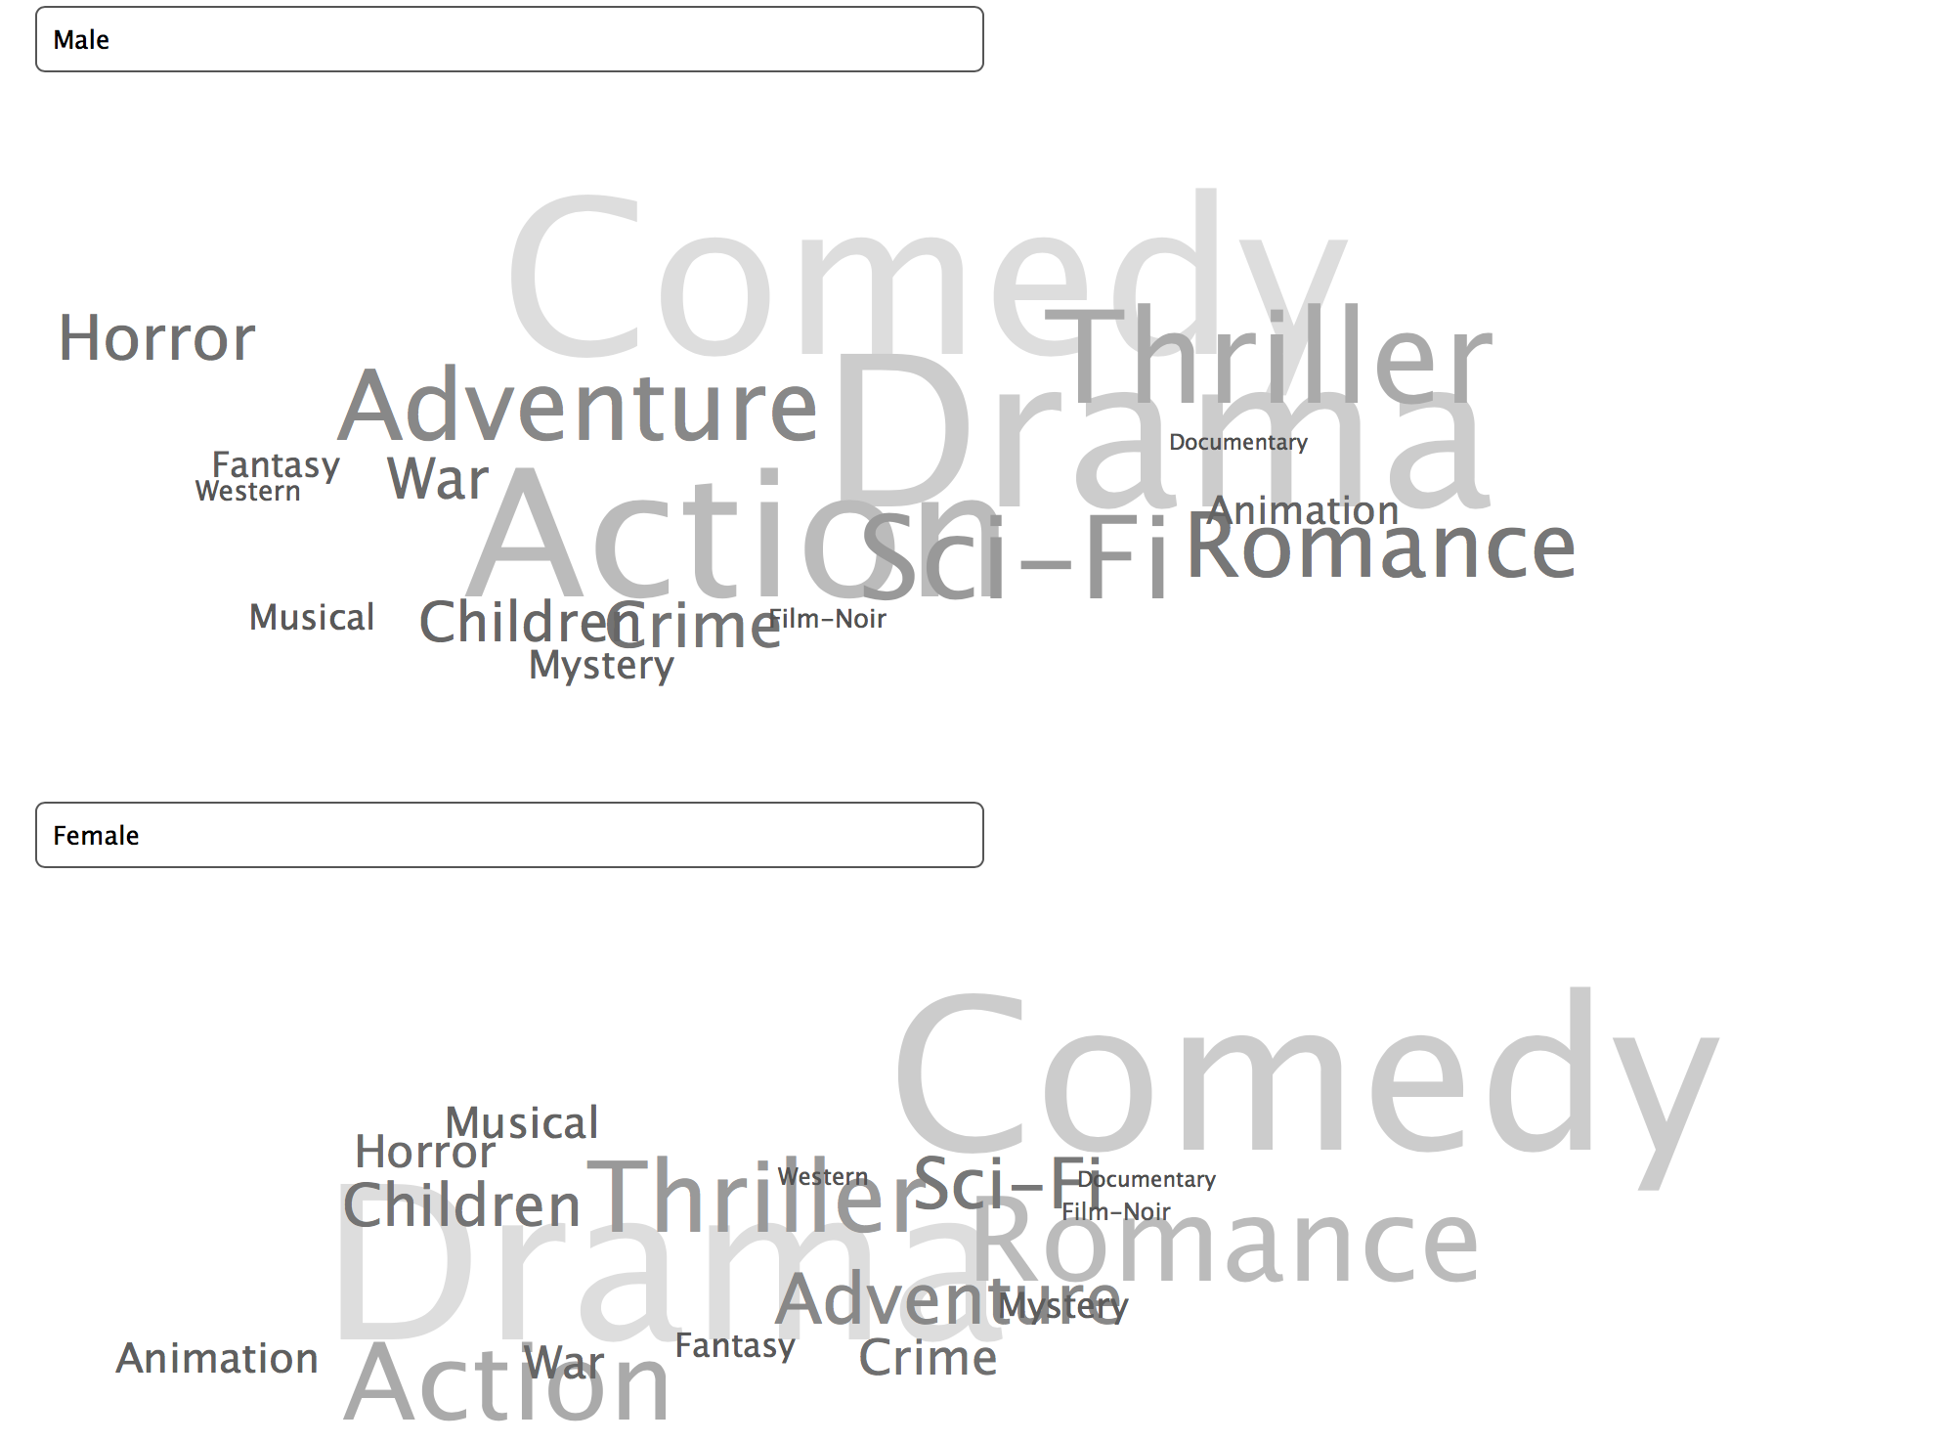
3. Word Cloud – Genre Popularity by Gender
Task:
Illustrate genre popularity in female and male users
Visual Encoding:
Size & color saturation: larger size and lighter color suggests a higher popularity of the genre
Notes:
Top three genre for male users:
Comedy
Drama
Action
Top three genre for female users:
Drama
Comedy
Action

Slide 9
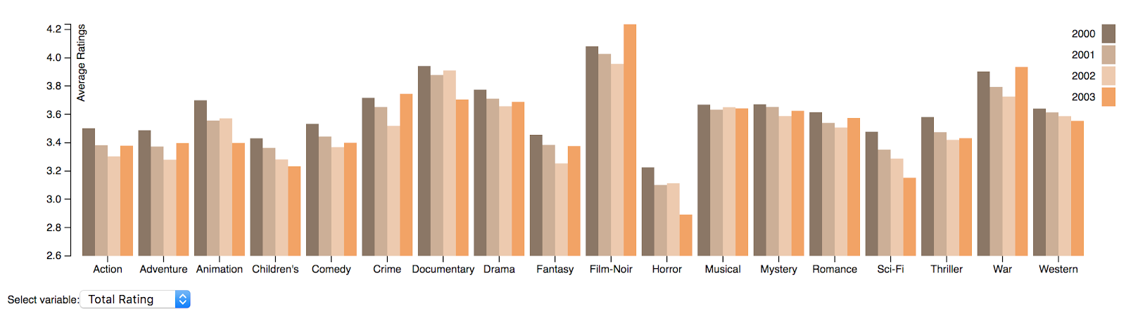
4. Trend of Genre Rating Over Years
Task:
Demonstrate the trend of average ratings per genre in gender segments over the year
Visual Encoding:
Position: positioned according to different genre
Color: the year ratings are made
Length: the amount of average rating
Notes:
Findings:
Rating of Animation, Children’s, Horror, Sci-Fi, Thriller, Western decreases over the four year
Female generally give a higher rating than male.

Slide 10
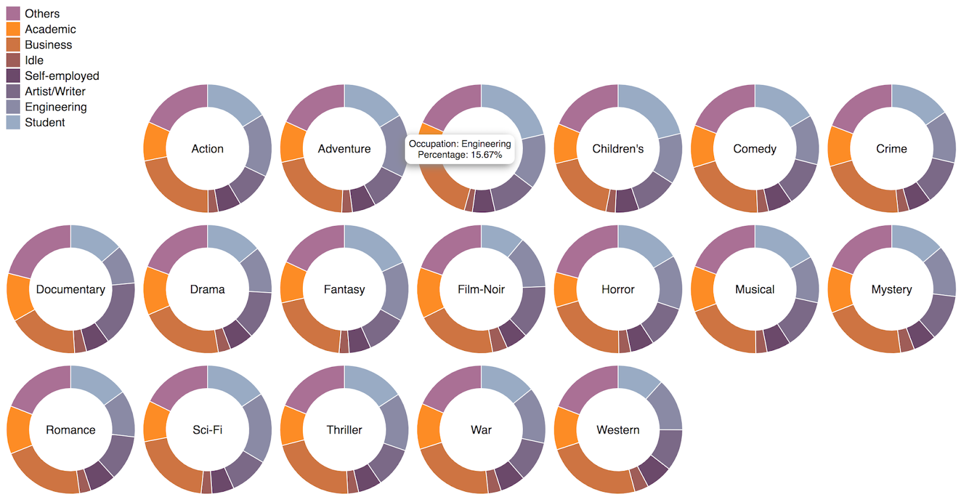
5. Occupation Distribution of the Genre
Task:
show the composition of users in each genre in terms of occupation
Visual Encoding:
Color: occupation of users
Area: proportion of each occupation
Notes:
Findings:
Major user segment: Students and business sector
Students have preference on Animation and children’s; Engineering is the major target of Sci-fi movies

Slide 11
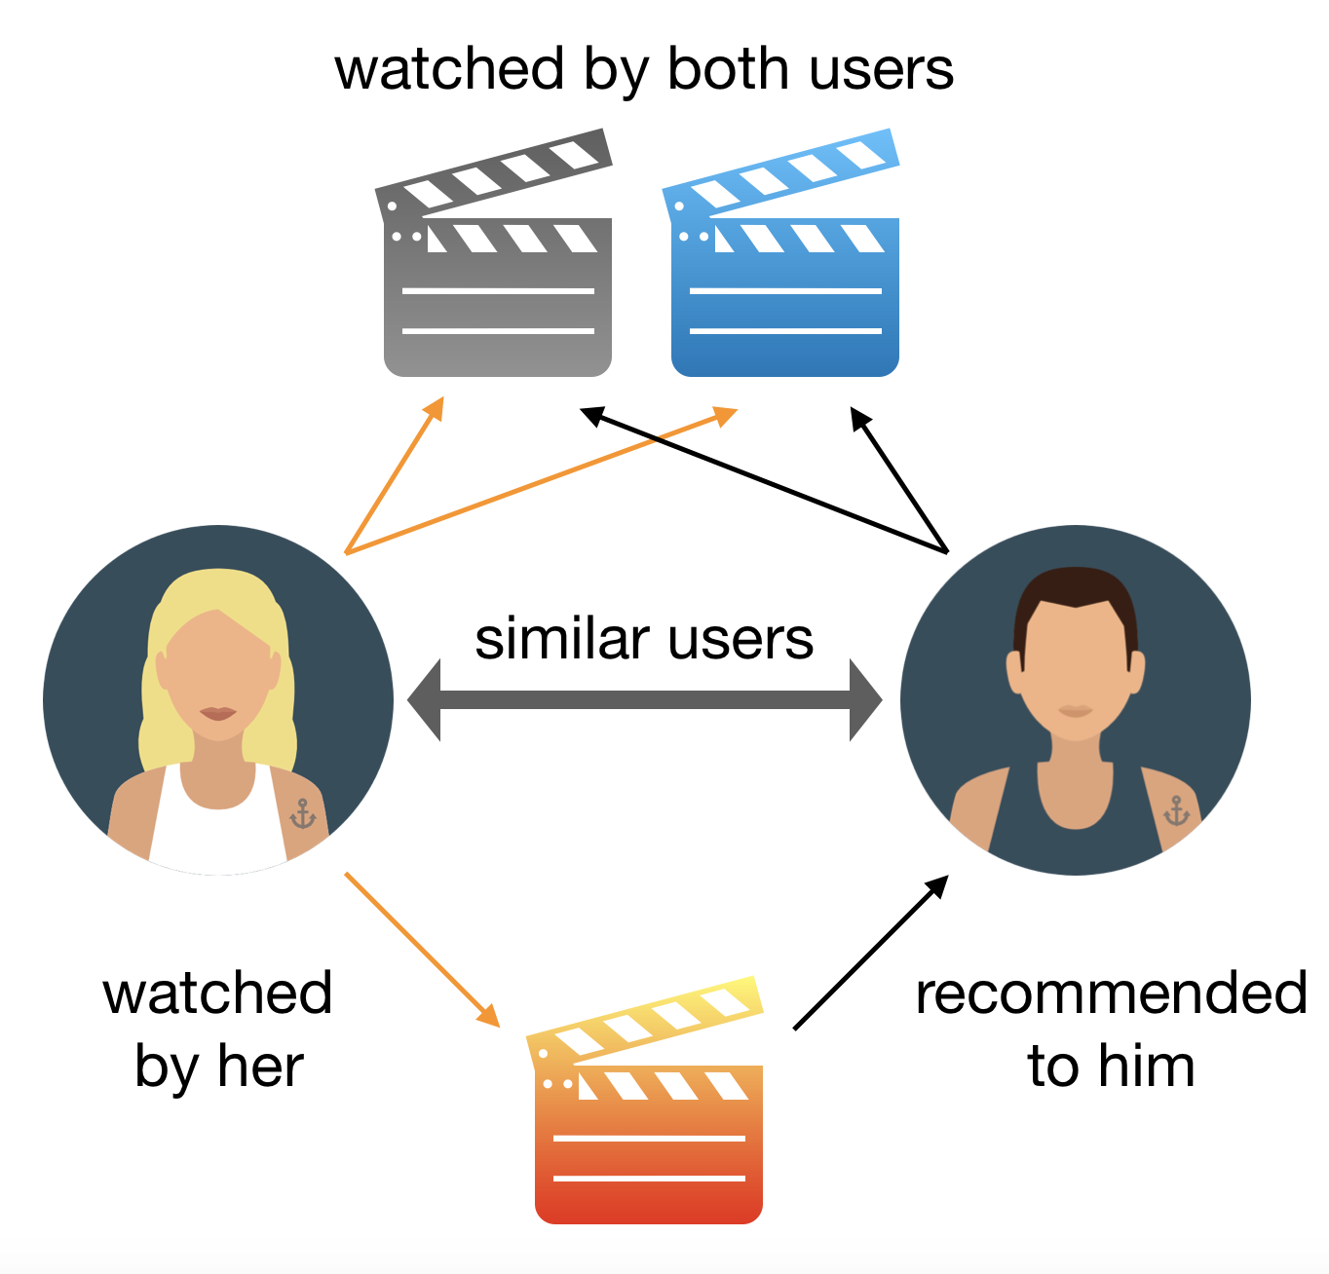
6. Movie Recommendation System
Our System:
Find top 20 similar users based on the input movie
Output 5 recommendation movies based on similar users’ records
Conduct the recommendation process recursively for the 5 recommendation movies
Output of a two layer radial tree
Collaborative Filtering System
Source:https://towardsdatascience.com/how-to-build-from-scratch-a-content-based-movie-recommender-with-natural-language-processing-25ad400eb243

Slide 12
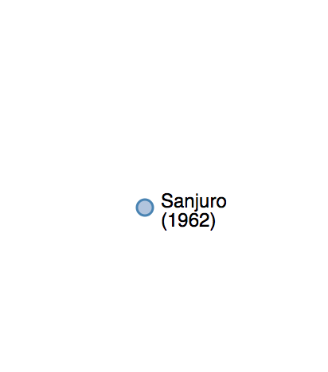
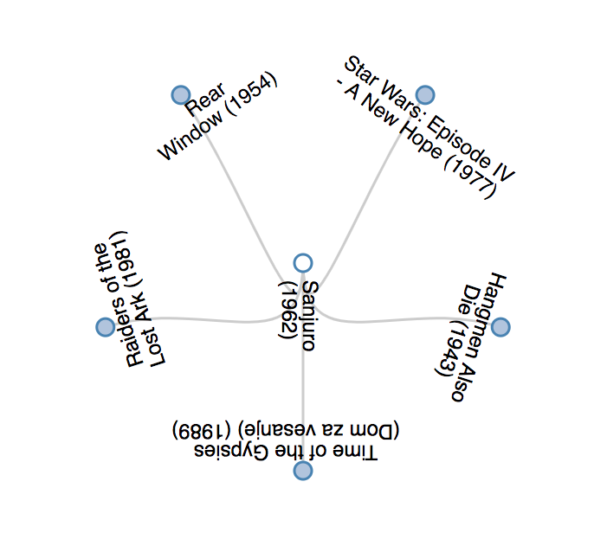
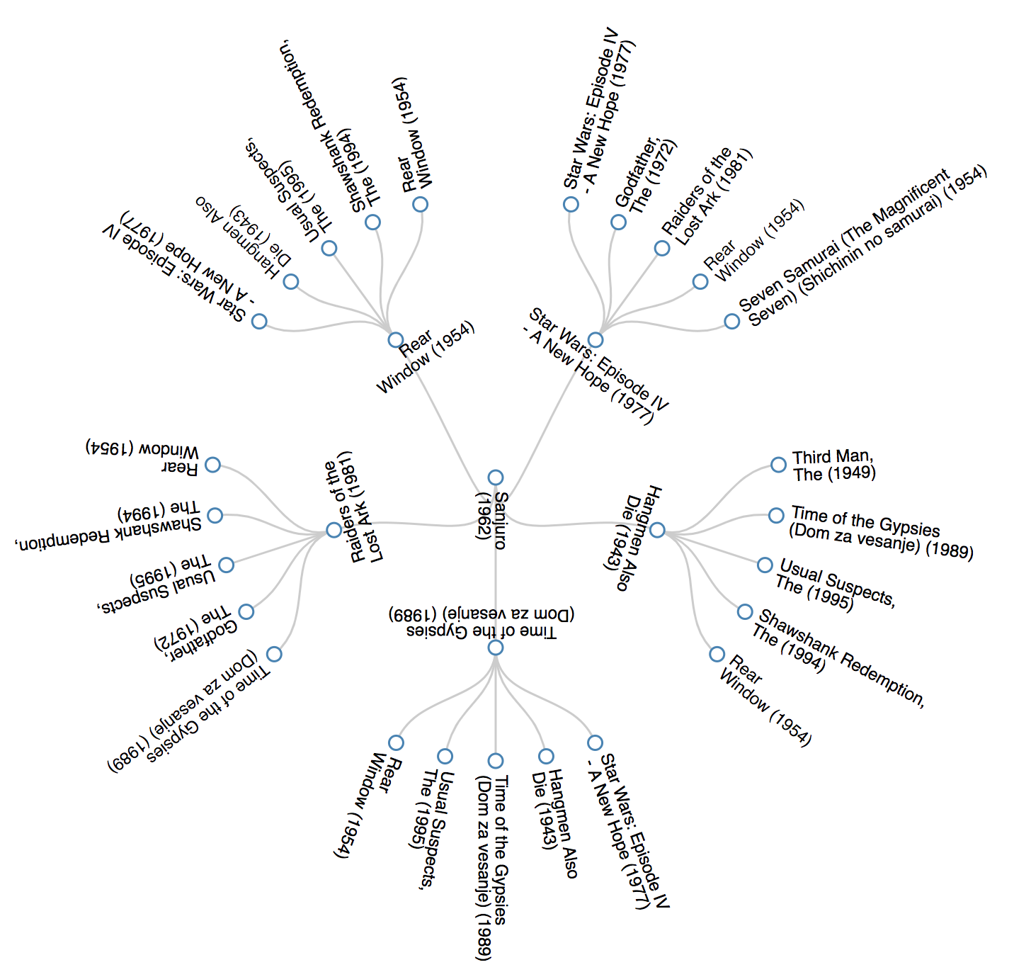
6. Movie Recommendation System—Radial tree visualization
First layer of recommendation – the system will recommend five movies from the root node using collaborative filter methodology
Second layer of recommendation – the system recommend movies based on the children nodes in the first layer
Root Node – Click the movie if you are interested

Slide 13

Live Demo…...

Slide 14
Thank you!

Slide 15
Q&A

